Slide 1

Supply Chain Attack Simulation & Defence Platform 3 attack simulations · 3 defence tools · live SIEM dashboard
10 slides

Slide 2
PLATFORM OVERVIEW
ATTACKS
DEFENCES
SIEM DASHBOARD
ATK1 — Typosquatting
crypt0 homoglyph & Levenshtein-1 fakes
DEF1 — Name Checker
Levenshtein + homoglyph vs known-good list
Live KPI Cards
Total events, block rate, missed, triage
ATK2 — Dependency Confusion
internal-utils 9.9.9 on public PyPI
DEF2 — SafePip
Intercepts pip; flags wrong-registry resolves
Event Feed
Colour-coded severity, timestamps
ATK3 — CI/CD Injection
Unpinned GitHub Action hijacked post-publish
DEF3 — Provenance Verifier
Hash + SLSA provenance; flags unpinned refs
Visualisations
Block-rate gauges, 24 hr heatmap, triage queue

Slide 3
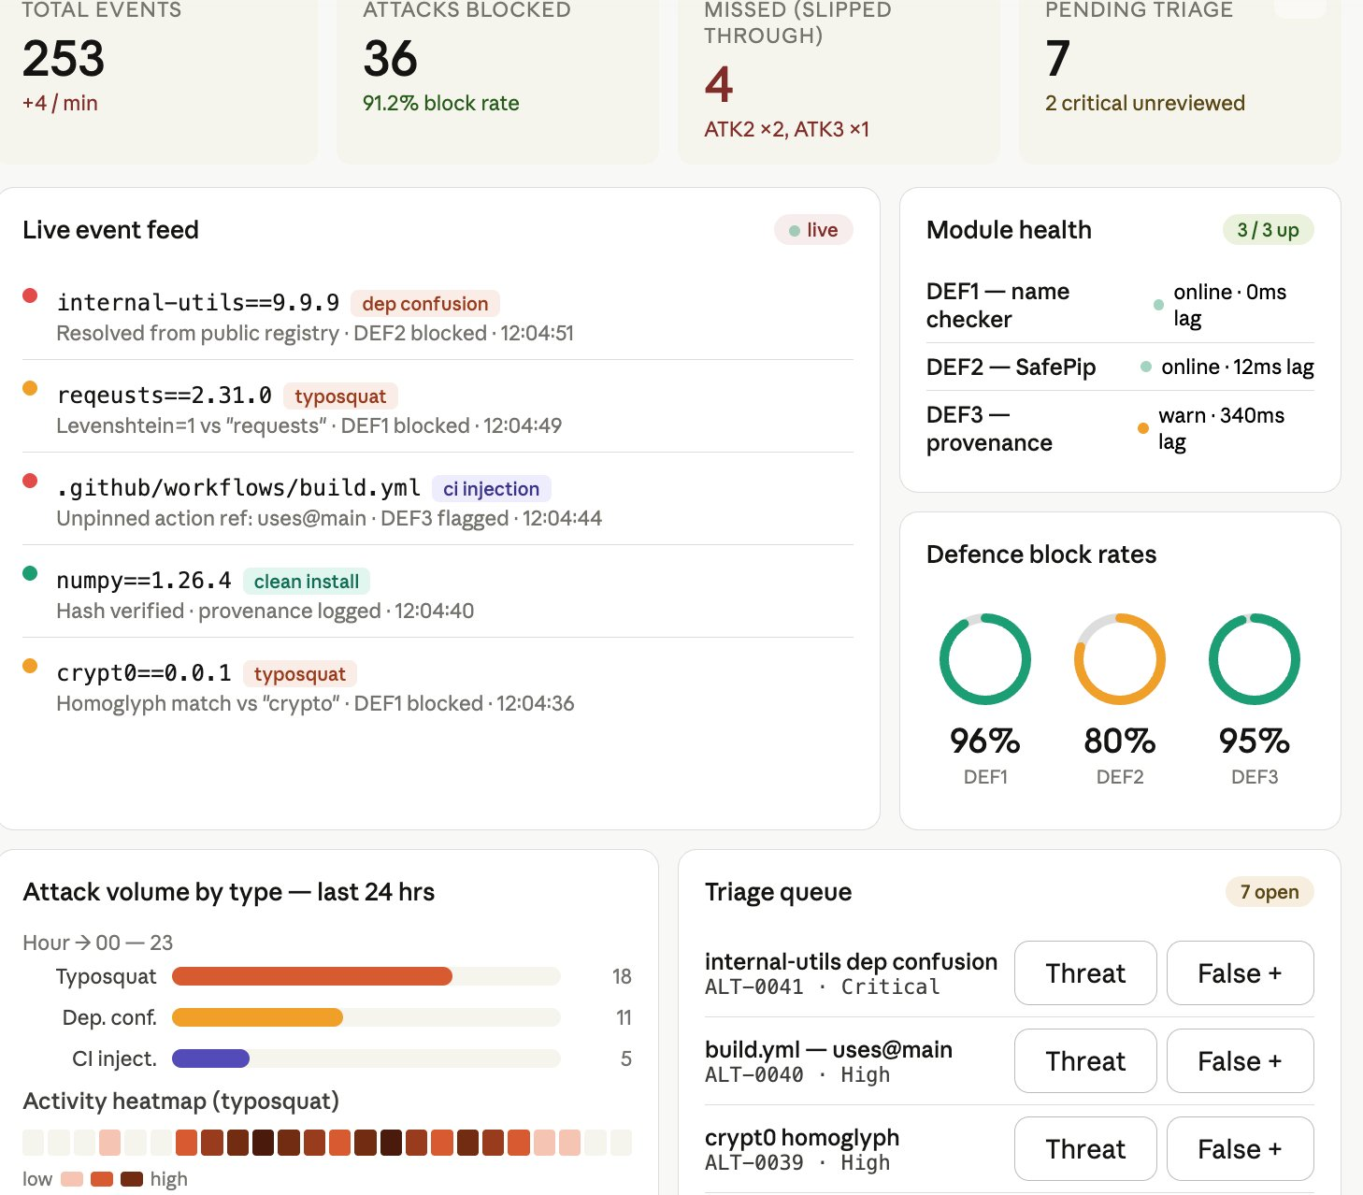
SIEM DASHBOARD
Tier 1
Live KPI cards (total / blocked / missed / triage)
Colour-coded event feed with package names
Block-rate gauges per DEF tool
Tier 2
Triage queue with Threat / FP buttons
Module health panel with latency per tool
Activity heatmap — 24 hr intensity grid
Tier 3
Scenario selector (ATK1/ATK2/ATK3 toggle)
Attack replay slider — scrub event timeline
Dark mode · PDF export
Single React SPA · polls /api/events every 2 s · no WebSocket complexity

Slide 4
ARCHITECTURE & KEY FACTS
Build Sequence
Highlights
1
Python virtual env
INF-01
5
Typosquatting ↔ Name Checker
ATK1+DE
10
3+3
Requirement sections covered
Attack + defence pairs, fully paired
2
Local mock registry ★
INF-02
6
Dep. Confusion ↔ SafePip
ATK2+DE
91%
2 s
Simulated block rate (DEF2 ~80%)
Dashboard poll interval
3
Log store + event schema
INF-03
7
CI Injection ↔ Provenance
ATK3+DE
Why local registry?
Are payloads safe?
Why 80% on DEF2?
4
Malicious Package Builder
MPB
8
Dashboard & visualisations
SIEM
Ethics & reproducibility — fully offline
Write to /tmp only, one log event
Dep. confusion timing window — tracked on SIEM

Slide 5
Resources
Williams, L., Benedetti, G., Hamer, S., Paramitha, R., Rahman, I., Tamanna, M., Tystahl, G., Zahan, N., Morrison, P., Acar, Y., Cukier, M., Kästner, C., Kapravelos, A., Wermke, D., & Enck, W. (2025). Research Directions in Software Supply Chain Security. ACM Trans. Softw. Eng. Methodol., 34(5), 146:1-146:38. https://doi.org/10.1145/3714464
[5] OpenSSF, "OpenSSF Scorecard — Security Health Metrics for Open Source," 2022. [Online]. Available: https://securityscorecards.dev

Slide 6
THANK YOU!

